Slide 1
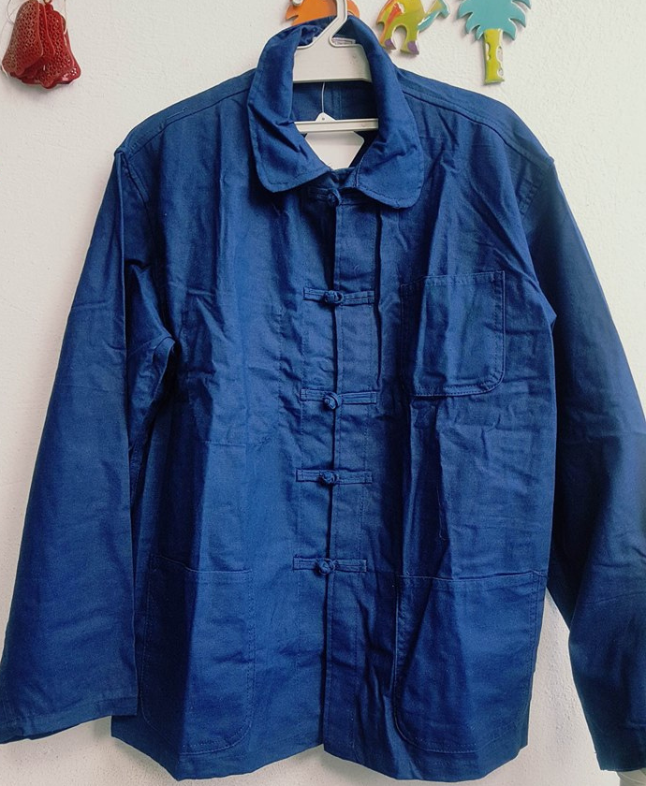

Dengri
Term Project
HGLINK Consulting

Slide 2








Outline
Introduction
Analysis Results
Research problem&objectives
Limitations
Approach to the problem
Recommendation
Research Design
Conclusion

Slide 3
Introduction
As people are getting more comfortable with social media networks and as it is becoming a major way to generate leads for companies, this marketing research project comes to clarify our client's ambiguities towards consumers' behavior and intentions if they opt for social media as a channel to sell the Tunisian "Dengri".

Slide 4
Industry
Product
A Modern Tunisian traditional clothing: "Dengri" having a price between 100 and 400 TND and to be sold on social media channels.
Textile and clothing:
The first industry in terms of employment and number of enterprises.

Slide 5
Marketing Research Problem
To examine the reliability of s-commerce through studying the behavior of consumers behavior, purchase intentions and motives of switching from shopping in stores to shopping on social media.

Slide 6
Objectives
1) Study the change in the respondent's behavior.
2) Examine the reliability of social media as a channel.
3) Identify the motives of switching to s-commerce.
4) Identify the most effective social media network channel.

Slide 7
Approach to the problem
}
Problem audit (asked 3 traditional clothing sellers)
Focus group (on a sample of 4 individuals)
Gathered and analyzed secondary data on the different aspects of the problem.
developed research questions and hypotheses to be tested.
To understand the problem at hand.

Slide 8
Research Design
1.Exploratory: To understand the problem.
2.Descriptive:
Our target sample size was set to 385.
Data collection leading to 177 positive responses.
Convenience technique through online surveys posted on social media (Facebook traditional clothing groups and Instagram).
To avoid missing data, we made survey questions all mandatory.
We used scales such as Likert scales of 5 and 7 points.
Data cleaning on Excel and Data analysis on SPSS.
3.Causal: Performed hypothesis testing on cause/ effect relationships.

Slide 9
Analysis of Results
Gender distribution
Age distribution
Refused
1.1%
between 32 and 45
9.9%
under 20 and
9.5%
Male
40.1%
between 25 and 30
17.2%
Female
58.8%
between 20 and 25
63.4%

Slide 10

Analysis of Results
Willingness to Buy Dengri
People are willing to buy Dengri if someone recommended it to them
58.2 %
People are willing to buy Dengri Given a price between 100 and 400 TND
23 %
People are willing to buy Dengri on social media
60.5 %

Slide 11
Motives to switch for s-shopping
50.3% of respondents find that social media shopping provides diverse choice.
Around 50% of respondents find that social media shopping reduces efforts.
45% of respondents think that social media shopping makes buying easier.
46% of respondents think that social media improve shopping experience.
33.9% of respondents think that social media ensures client’s safety.
27.1% of the respondents think that social media provide credible and transparent reviews.

Slide 12
Reliability of Social Media
(67.2%) find that Payment accessibility and security is very important
(79.1%) find that meeting the promised product quality is important
(62.1%) find that product description and information
(58.8%) find that delivery service is the very important
These variables are the top factors determining the reliability of social media according to respondents.

Slide 13


Most used Social Media
Facebook is rather used for shopping.
Instagram is the social media network that has the highest time spent.
Instagram as their most preferred Social Media platform.

Slide 14
General Results
Price range of 100-400 TND affects negatively the willingness to buy meanwhile recommendation affects it positively.
Diverse choice, efforts reduction and improvement of shopping experience are the main motives leading to switching to S-commerce.
The top factors determining the reliability of social media are Payment accessibility and security, finding the promised product quality and product description and information.

Slide 15
General Results
Instagram and Facebook are the most used social media channels yet online shoppers prefer Facebook.
Delivery time, secure payment and quality of the product delivered are the most important factors influencing the satisfaction.
The main respondents willing to buy the product proposed online are women.

Slide 16
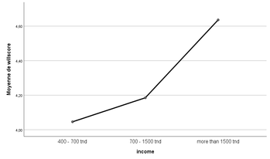
Income and Willingness to buy Degri on SM
One Way ANOVA TEST for the relation between income and willingness to buy Dengri on social media.
There is no correlation between the willingness to buy and income.

Slide 17
Multiple regression
One of the hypothesis that we tested is:
the motives of switching to social media shopping is dependent on the willingness to buy Dengri, the reliability of social media as a s-shopping tool, and the satisfaction based on previous experiences
=>Multiple regression on dependent variable (motive score) and independent variables: (willingness to buy, reliability score and satisfaction score)

Slide 18
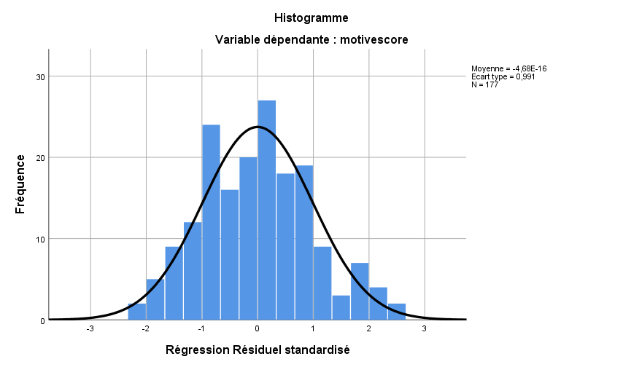
we found out that the multiple regression the motive score has a dependency relationship with willingness to buy and satisfaction score but not reliability.

Slide 19

Recommendation
Based on our research we present the following set of recommendations.
➢ Since 64.4% of our respondents are between 20 and 25 and their income is usually no less than 700 TND we suggest that the product should be offered on social media for this large category, although the price range affects the willingness to buy negatively still the price range of 100 – 400 TND should be more precise.
➢ Since Instagram and Facebook are the most used social media channels for shopping, so as a start we recommend promoting Dengri on these networks as it will be more exposed and recognized by its users.

Slide 20
Recommendation
Ensuring the payment accessibility and security and the promised product quality should be the main factors to focus on because respondents are more concerned about authenticity and security.
Delivery service is a plus in S-commerce and most respondents find it an important and motivation aspect so adapting to this option is highly recommended since nearly 50% are distributed far from Grand Tunis and might be interested in buying the product. ➢
Since the female and male respondents results are almost equally distributed opting for unisexual designs would be more appealing.

Slide 21

Limitations
Time: we took a lot of time preparing the designs, the questions and the variables of measurements because we couldn’t convince each other in discussion so we started the data collection late; meaning we uploaded the survey on social media for only 2 weeks.
The length of the survey has affected the willingness of the respondents to answer.
we didn’t reach the optimal sample size needed for the analysis moreover the number of positive responses obtained was small.

Slide 22
Limitations
There was a mistake in the branching of the previous online shopping experience in the form; meaning people who chose ‘’no’’ as answer for ‘’did you previous make an online purchase’’ finished the form and gave an opinion of whether their online shopping experience was satisfying or not.
Not including a perception of the product variable as we were doing the analysis we noticed that it was needed to understand certain interrelations.

Slide 23

Conclusion
According to the research that we have conducted, we can conclude that S-commerce for traditional clothes is being adopted by Tunisian consumers little by little.
Individuals from our sample are now aware of Social Media shopping and they are ready to opt for it as an option.
Traditional clothing companies need to keep innovating and listening to their customers in order to provide the best experience and to stay ahead of the trends.

Slide 24
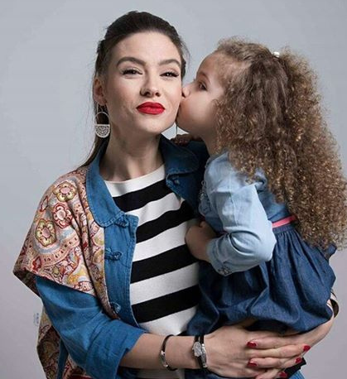
Thank you for
your attention !
Presented by:
Hadil Mhedhbi
Leena Zouaoui
Ghaufrane Zaidi
Khalil Boughzou
Naoures Juoini
Isra Zitouni

